Slide 1
How to run Avant-garde

Slide 2
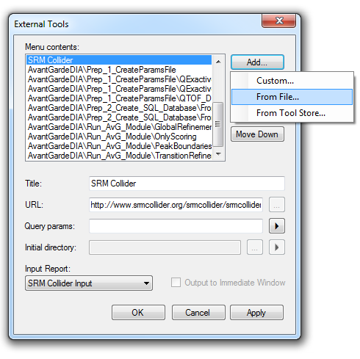
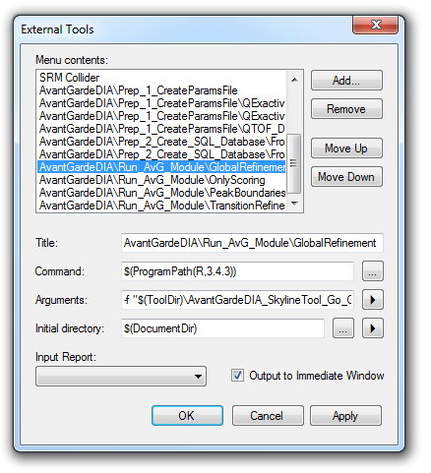

Install Skyline External tool
Go to: Tools → External tools
Select Zip file
Of Avant-garde DIA
Skyline External tool

Slide 3
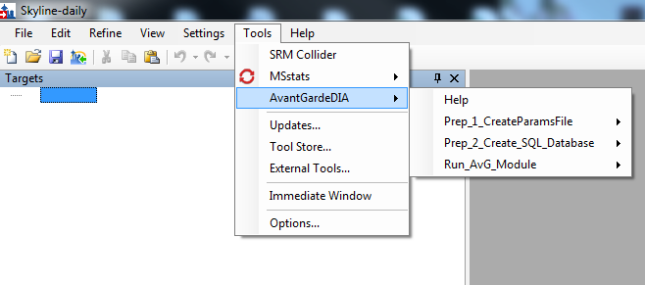
Overview
Preparation scripts (Run only once):
Create Parameters File:
- Writes parameters file (.R file)
- User-defined parameters
DB:
- Creates SQLite database containing data and metadata
Avant-Garde DIA modules:
'GlobalRefinement' for
transition refinement
peak boundaries refinement
peak rescoring
'TransitionRefinement' for
transition refinement
peak rescoring
'PeakBoundariesRefinement' for
1) peak picking
2)peak rescoring
'OnlyScoring' for
1) peak rescoring

Slide 4
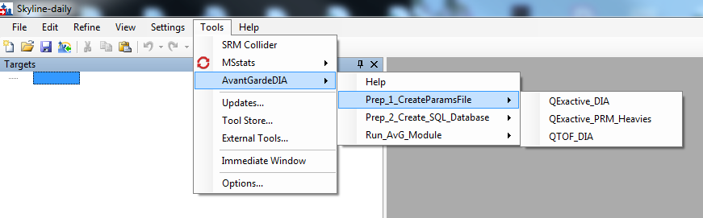
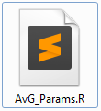
Preparation Step 1: Create parameters file
This step creates:
Parameters file (.R file) with correct format
Folders for outputted intermediary data and results
Default parameters files for three applications are given here
Qexactive_DIA: DIA dataset analyzed on a Q-Exactive series instrument
Qexactive_PRM_Heavies: PRM dataset analyzed on a Q-Exactive series instrument containing light and heavy peptides for all analytes.
QTOF_DIA: DIA dataset analyzed on a Q-TOF instrument (SWATH)
All files will be written to the “AvantGardeDIA” folder in the same location as the Skyline File

Slide 5
Preparation Step 1: List of parameters
Parameter | Default | Comment
Name_Tag | 'Name_Tag' | Short Name that will be added to all output files. (Must be in quotes)
MinimalInitialNumberOfTransitions_Filter | 5 | Peptides with less than N transitions will be removed and not included in the SQLite Database
RemoveTransitionBelowOrdinal_Filter | 3 | Transition ordinal below or equal to this value will be removed (for example if Max_TransitionIonOrdinal=3 transitions b1,b2,b3,y1,y2,y3 are removed)
RemoveSharedTransitionsBetweenLightAndHeavy_Filter | TRUE | Should be TRUE for DIA,FALSE for PRM.
ReadNumberOfLines | 20000 | The CSV file is read in chunks. This parameter sets the number of lines in each chunk.
NonZeroBaselineChromatogram | FALSE | TRUE for data having high noise baseline level (e.g. SWATH data on Q-TOF), FALSE (noise-reduced data, e.g demultiplexed Overlap DIA Data acquired on Q-Exactive series)
MinimalNumberOfTransitionsAfterOptimization | 4 | The optimization will find the best solution that will have at least this number of transitions.
KeepPeptidesWithLowerNumberOfTransitions | FALSE | Keep (or not) a peptide if it has a lower number of transitions than the limit above (recommended FALSE for DIA). The transition refinement will not be done on these peptides but the peak boundary refinement and scoring will be performed.
TopN_RankedbyIntensity | 6 | Number of most intense transitions in teh spectral library (N) among which at least n transitions need to be present.
MinimalNumberOfTransitionsAmongTopN | 2 | Number of transitions (n) that need to be present among the N most intense transitions in the spectral library.
alpha | 0.005 | AvG Fitness score: Intensity score coefficient
Beta | 0.05 | AvG Fitness score: Mass error score coefficient
SpectralLibraryDotProduct_limit | 0.7 | Library dot product cut off
MassError_Tolerance | 10 | Mass error tolerance (in PPM)
MassError_CutOff | 20 | Mass error cut-off (in PPM)
MinimalNumberOfConsecutivePoints | 3 | Minimal number of consecutive points above the limit of noise to consider a signal as a potential peptide.
MinimalIntensityPercentagePerTransition | 3 | Minimal percentage of the maximum intensity of each transition below which any point is no longer considered.
UseHeavyPeakBoundariesForLight | FALSE | Use the heavy peptide peak boundaries for the light peptides.
Default values for “QExactive DIA” example

Slide 6
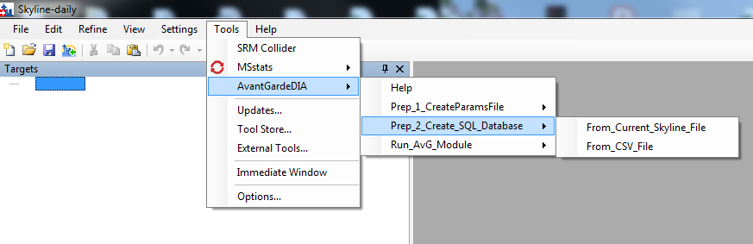
Preparation Step 2
Exports CSV file into a temporary folder
Transforms CSV file into a SQLite file
Works better for small files (PRM)

Slide 7
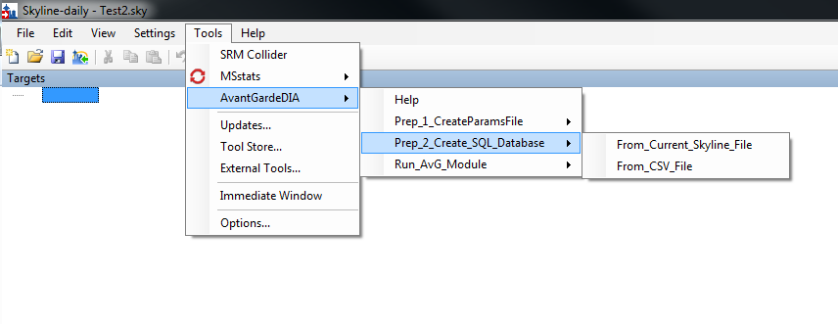
Preparation Step 2
For large dataset (DIA):
Export → Report → AvantGardeDIA_Export.csv inside the “AvantGardeDIA” folder that was created in preparation step 1
Launch AvantGardeDIA →Prep2_Create_SQL_Database →From_CSV_File
This transforms the CSV file into a SQLite file
For files larger than 2Gb
AvantGardeDIA_Export.csv
DB_Name_Tag.sqlite

Slide 8
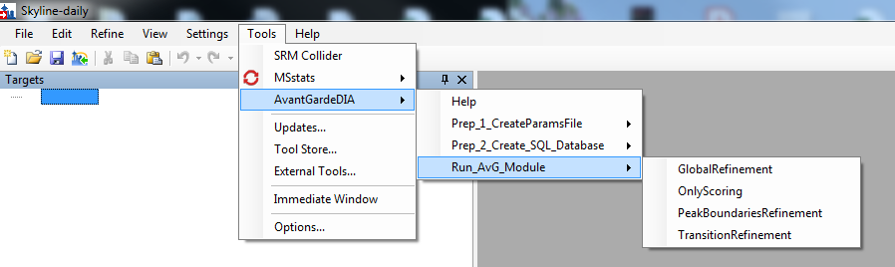
Run Avant-garde DIA
Choose the module that you would like to run
The preparation steps should be run only once. They should not be launched again every time a new module is used.
Parallelized analysis: AvG uses N-1 cores (where N is total number of available cores)

Slide 9
Import Results
Import results into Skyline:
Import → Peak boundaries → “GR_NewPeakBoundaries_Name_TAG_Formatted_Filtered.csv”
Import→ Annotations → “GR_Transitions_Annotations_Name_TAG.csv”
Prefix indicating the results of each module
GR_ : Global refinement
TR_: Transition refinement
PB_: Peak Boundaries
NO_: Ony Scoring (No Optimization)
Name of the project that is indicated in the Parameters file
The Transitions_Annotations will complete the “quantitative” annotation for each transition in Skyline.
Quantitative= TRUE means that the results of the transition will be used.
Quantitative= FALSE means that the results of the transition can be observed but its results will not be considered.

Slide 10
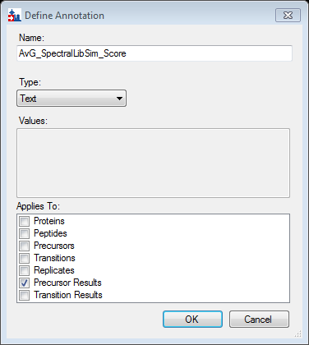
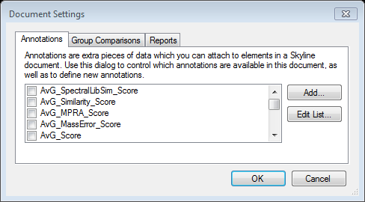
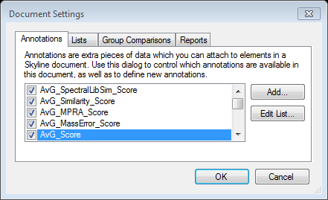
Import and view Scores directly in Skyline
This step is not necessary but it can be helpful to have the scores imported into Skyline.
To import the scores into skyline:
Settings → Document Settings
Create the following 5 annotation fields
The names should be the same as below
All of them choose:
Type: Text
Applies to: Precursor Results

Slide 11
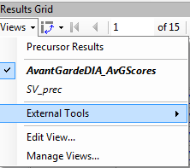
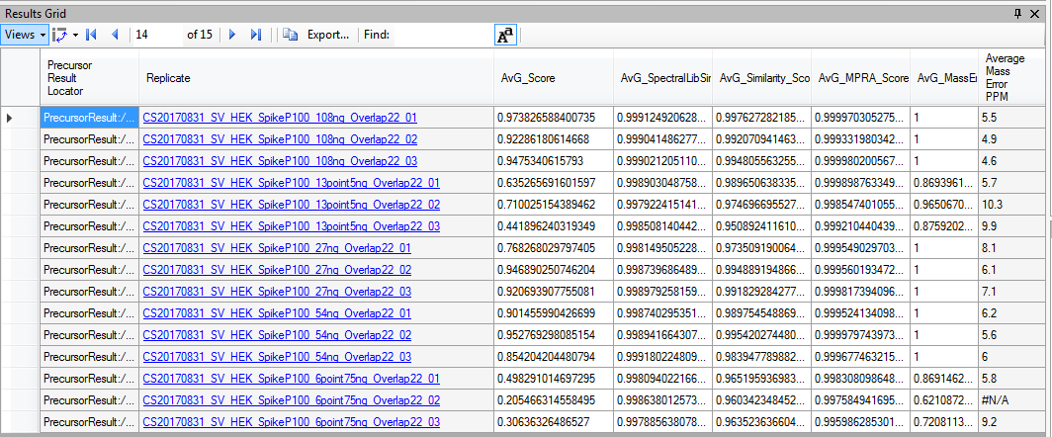
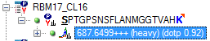
Import and view Scores directly in Skyline
Open Results_Grid
Select AvantGardeDIA_AvGScores
When a precursor is selected the AvG subcores and the AvG Score are shown.
Import→ Annotations → “GR_AnnotationsPrecursorResults_Name_TAG.csv”

Slide 12
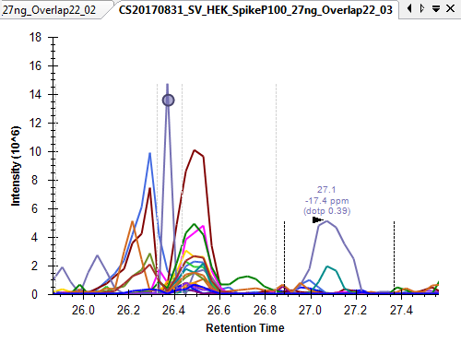
Example
LAAPSVSHVSPR
Before Avant-garde
Peak boundary adjustment
Only quantitative transition
Avant-garde

Slide 13
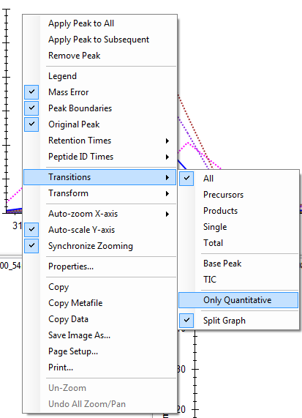
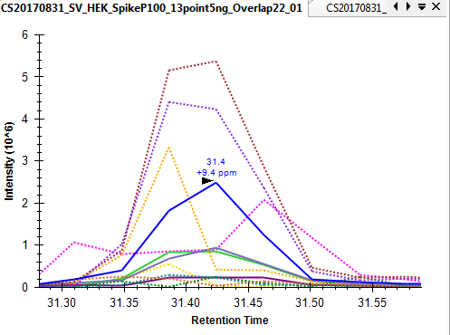
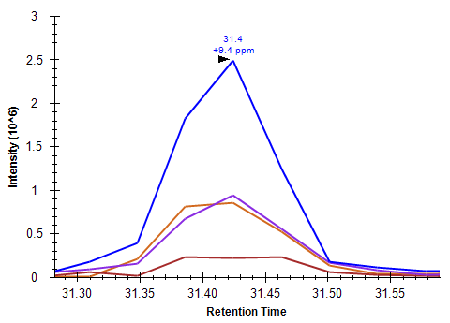
How to see only quantitative transitions
SPPAPGLQPMR
Non quantitative transitions
Quantitative transitions

